Slide 1
IIIT ALLAHABAD
DAA432C
Assignment-02
Presented By:
IIB2019034-Sanket Kokude
IIB2019035-Harshit Kumar
IIB2019036-Viful Nirala

Slide 2
Problem Statement
Given an array arr[] of n numbers and a number K, find the number of subsets of arr[] having XOR of elements as K. Solve using Dynamic programming

Slide 3
Introduction
Given an array arr[] of size n ,we used dynamic program-
ming approach to find the number of subsets having XOR
value as K.
Dynamic Programming (DP) is an algorithmic technique for
solving an optimization problem by breaking it down into
simpler subproblems and utilizing the fact that the optimal
solution to the overall problem depends upon the optimal
solution to its subproblems.

Slide 4
ALGORITHM DESCRIPTION
First we find a number m, which is actually the maximum value any XOR subset can acquire. We define a number m such that m = pow(2,(log2(max(arr)) + 1))–1.
After that check whether the given k is greater or not if it is then return 0.
After that create a 2D array dp[n + 1][m + 1], such that dp[i][j] equals to the number of subsets having XOR value j from subsets of arr[0. . . i − 1].
We initialize all values of dp[i][j] as 0.
Set value of dp[0][0] = 1 since XOR of an empty set is 0.

Slide 5
Iterate over all the values of arr[i] from left to right and for each arr[i], iterate over all the possible values of XOR i.e from 0 to m (both inclusive) and fill the dp array as following: for i = 1 to n: for j = 0 to m: dp[i][j] = dp[i-1][j] + dp[i-1][j^arr[i − 1]].
This can be explained as, if there is a subset arr[0. . . i-2] with XOR value j, then there also exists a subset arr[0. . . i-1] with XOR value j also if there exists a subset arr[0. . . .i-2] with XOR value j ⊕ arr[i] then clearly there exist a subset arr[0. . . i-1] with XOR value j, as: j ⊕ arr[i − 1] ⊕ arr[i − 1] = j.
Counting the number of subsets with XOR value k: Since dp[i][j] is the number of subsets having j as XOR value from the subsets of arr[0..i-1], then the number of subsets from set arr[0..n] having XOR value as K will be dp[n][K].

Slide 6
ALGORITHM ILLUSTRATION:
Suppose a given array is arr = [6, 2, 4, 3, 5] and K = 6.
Then find a number m which is the maximum value any XOR subset can have, by
m = 2^Log2(max(arr))+1) – 1 ,as max(arr) = 6 => m = 2^Log26 – 1 i.e.m = 7.
Then initialise dp (2D array dp[n + 1][m + 1]) with all values as 0 where n = sizeof(arr) i.e n = 5.
dp[0][0] = 1(Empty set)
Now we Iterate over all values of arr[i] from i=1 to i=n.Then for each iteration ,we also iterate over all values of XOR.
The Final Matrix is:
Hence, number of subsets having XOR value k is dp[n][k] = dp[5][4] = 4.
1 | 0 | 0 | 0 | 0 | 0 | 0 | 0
1 | 0 | 0 | 0 | 0 | 0 | 1 | 0
1 | 0 | 1 | 0 | 1 | 0 | 1 | 0
2 | 0 | 2 | 0 | 2 | 0 | 2 | 0
2 | 2 | 2 | 2 | 2 | 2 | 2 | 2
4 | 4 | 4 | 4 | 4 | 4 | 4 | 4

Slide 7
Time complexity: We are iterating over whole array one by one finding and storing the count of possible subsets that generate a XOR value j (we say) and store it in the dp[i][j] which will need time to iterate over the array of size n and for each element a loop of time complexity m will be iterated. m = 2[log2(max−element)]+1 − 1 This will result in the time complexity of O(n ∗ m).
Space complexity: In this approach we will have to store the values for all possible cases that are generated, as the dp[i][j] requires dp[i − 1][j] and hence a 2D array of size n ∗ m is required. This will result in the space complexity of O(n ∗ m).

Slide 8
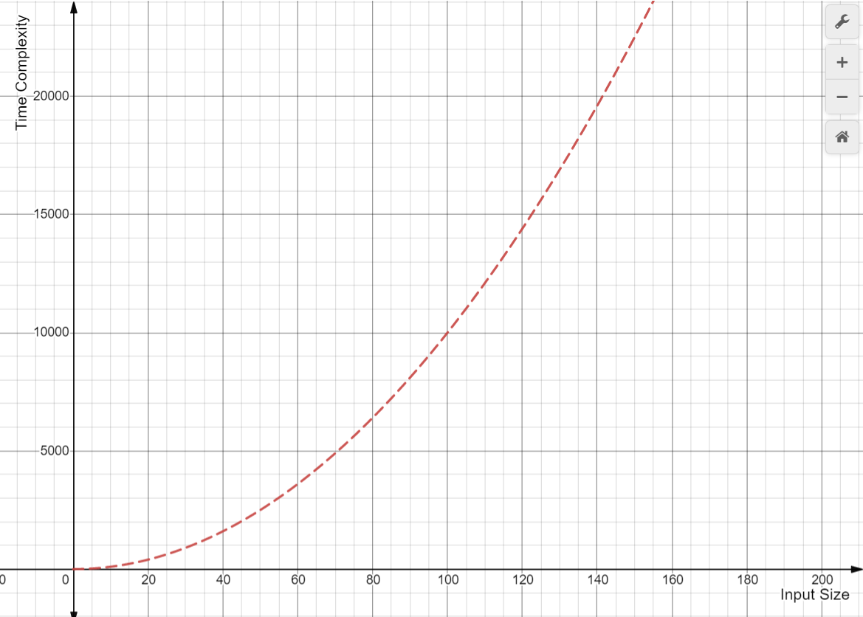
Time Complexity Curve:

Slide 9
Conclusion:
We can observe that in Dynamic Programming Approach it may consume more space (i.e.O(1) in case of brute force) but will have better time-complexity than Brute force approach(i.e.O(2n) in case of brute force).

Slide 10
Thank you!

